Slide 1
VIRTUAL MEMORY

Slide 2
1.Introduction
Virtual memory involves the separation of logical memory as perceived by developers from physical memory.
This separation allows an extremely large virtual memory to be provided for programmers when only a smaller physical memory is available
Virtual memory is a technique that extends a computer's RAM by using disk space. This allows programs to run as if they have more memory than they actually do.
HOW IT WORKS :
When RAM is full, less frequently used data is moved to a swap file on disk.
This process is called paging or swapping.
When the data on the hard disk is needed again, it is transferred back to RAM.

Slide 3
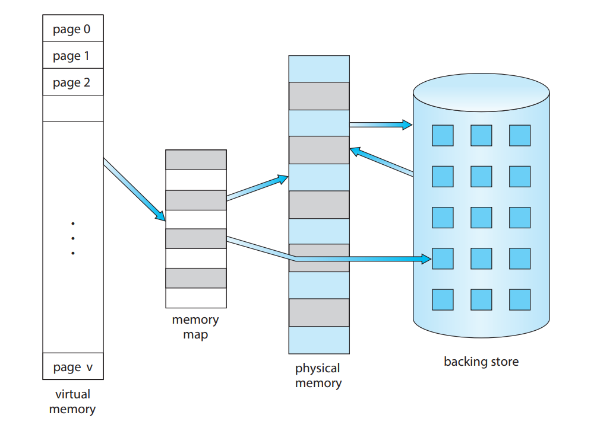

Slide 4
2. Demand Paging
Consider how an executable program might be loaded from secondary storage into memory.
  One option is to load the entire program in physical memory at program execution time.
  An alternative strategy is to load pages only as they are needed. This technique is known as demand paging and is commonly used in virtual memory systems
Demand paging is a technique used in virtual memory systems where pages enter main memory only when requested or needed by the CPU.
In demand paging, the operating system loads only the necessary pages of a program into memory at runtime, instead of loading the entire program into memory at the start

Slide 5
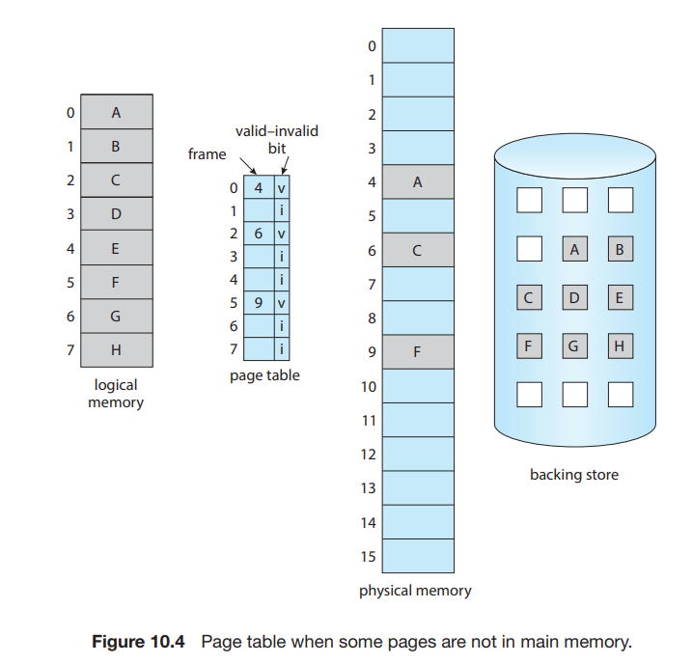

Slide 6
The general concept behind demand paging, is to load a page in memory only when it is needed.
As a result, while a process is executing, some pages will be in memory, and some will be in secondary storage.
Thus, we need some form of hardware support to distinguish between the two (VALID – INVALID BIT).
  When the bit is set to “valid”, the associated page is both legal and in memory.
  If the bit is set to “invalid,” the page either is not valid (that is, not in the logical address space of the process) or is valid but is currently in secondary storage.
The page-table entry for a page that is brought into memory is set as usual, but the page-table entry for a page that is not currently in memory is simply marked invalid

Slide 7
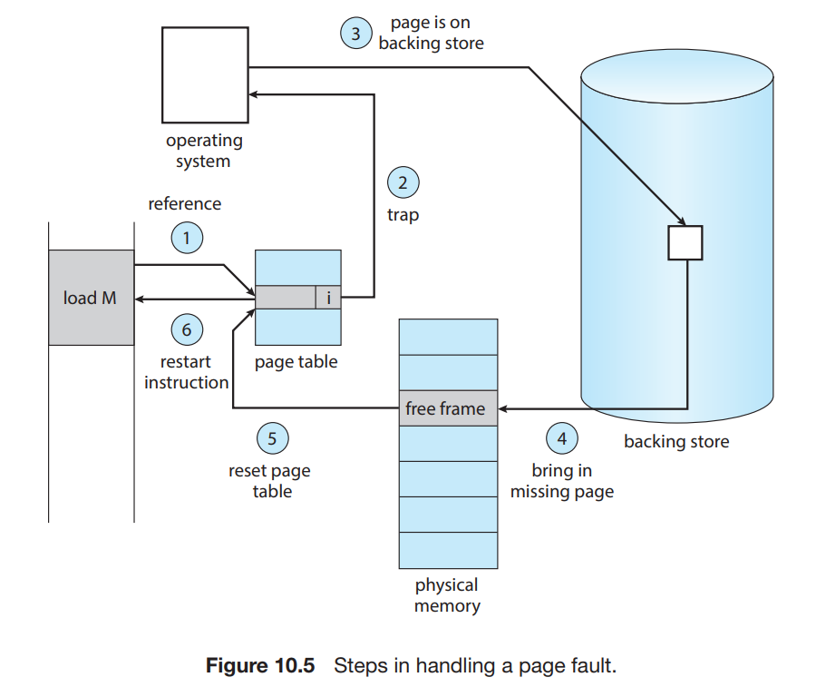
PAGE FAULT
Trying to access a page that was not brought into memory or marked invalid causes a page fault.

Slide 8
Procedure For Handling Page Fault
1. We check an internal table (usually kept with the process control block) for this process to determine whether the reference was a valid or an invalid memory access.
2. If the reference was invalid, we terminate the process. If it was valid but we have not yet brought in that page, we now page it in.
3. We find a free frame (by taking one from the free-frame list)
4. We schedule a secondary storage operation to read the desired page into the newly allocated frame.
5. When the storage read is complete, we modify the internal table kept with the process and the page table to indicate that the page is now in memory.
6. We restart the instruction that was interrupted by the trap. The process can now access the page as though it had always been in memory.

Slide 9
3. Page Replacement
Page replacement takes the following approach.
  If no frame is free, we find one that is not currently being used and free it.
  We can free a frame by writing its contents to swap space and changing the page table (and all other tables) to indicate that the page is no longer in memory

Slide 10
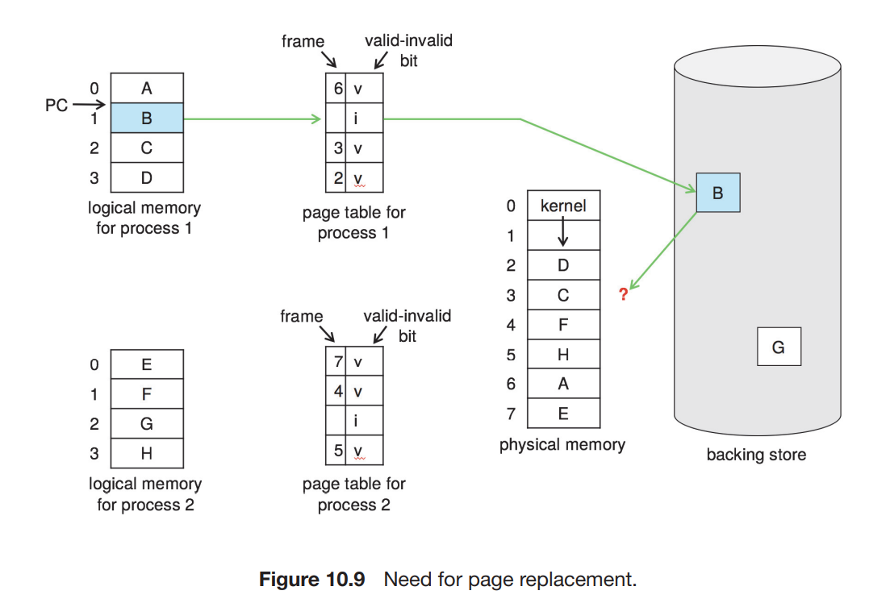

Slide 11
We modify the page-fault service routine to include page replacement:
  1. Find the location of the desired page on secondary storage.
  2. Find a free frame:
    a. If there is a free frame, use it.
    b. If there is no free frame, use a page-replacement algorithm to select a victim frame.
    c. Write the victim frame to secondary storage (if necessary); change the page and frame tables accordingly.
  3. Read the desired page into the newly freed frame; change the page and frame tables.
  4. Continue the process from where the page fault occurred.

Slide 12
3.1 Page Replacement Algorithms
FIFO Page Replacement
Optimal Page Replacement
Least Recently Used Page Replacement

Slide 13
3.1.1 FIFO Page Replacement
The simplest page-replacement algorithm is a first-in, first-out (FIFO) algorithm.
A FIFO replacement algorithm associates with each page the time when that page was brought into memory.
When a page must be replaced, the oldest page is chosen
the operating system keeps track of all pages in the memory in a queue, the oldest page is in the front of the queue.
  When a page needs to be replaced page in the front of the queue is selected for removal.

Slide 14
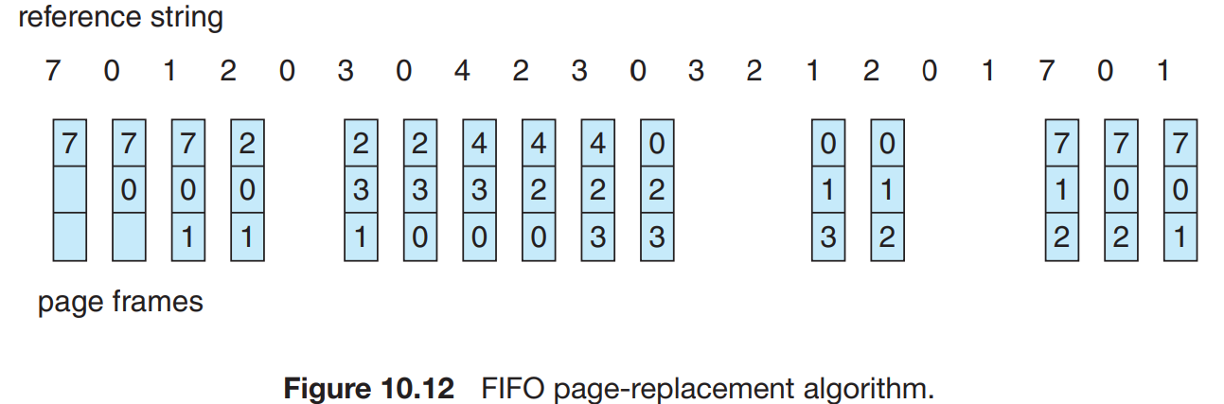
Apply the FIFO replacement algorithms for the following page-reference strings: 7 0 1 2 0 3 0 4 2 3 0 3 2 1 2 0 1 7 0 1

Slide 15
For our example reference string, our three frames are initially empty.
The first three references (7, 0, 1) cause page faults and are brought into these empty frames.
The next reference (2) replaces page 7, because page 7 was brought in first.
Since 0 is the next reference and 0 is already in memory, we have no fault for this reference.
The first reference to 3 results in replacement of page 0, since it is now first in line. Because of this replacement, the next reference, to 0, will fault.
Page 1 is then replaced by page 0.
This process continues as shown in Figure 10.12.
Every time a fault occurs, we show which pages are in our three frames. There are fifteen faults altogether

Slide 16
We would expect that giving more memory to a process would improve its performance
BELADY’S ANAMOLY : the page-fault rate may increase as the number of allocated frames increases

Slide 17
3.1.2 Optimal Page Replacement
An optimal page-replacement algorithm— the algorithm that has the lowest page-fault rate of all algorithms and will never suffer from Belady’s anomaly.
Such an algorithm does exist and has been called OPT or MIN. It is simply this:
  Replace the page that will not be used for the longest period of time.
Use of this page-replacement algorithm guarantees the lowest possible page fault rate for a fixed number of frames.

Slide 18
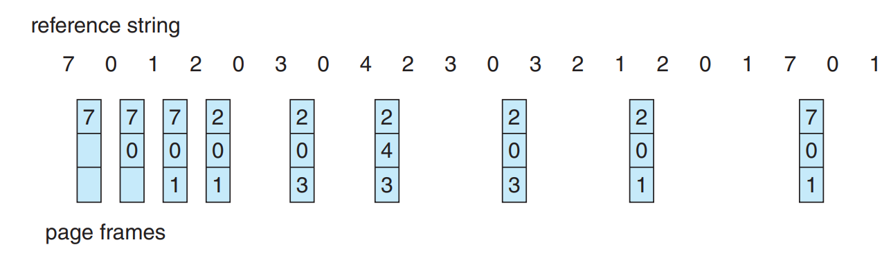
Apply the Optimal page replacement algorithms for the following page-reference strings:7 0 1 2 0 3 0 4 2 3 0 3 2 1 2 0 1 7 0 1

Slide 19
The first three references cause faults that fill the three empty frames.
The reference to page 2 replaces page 7, because page 7 will not be used until reference 18, whereas page 0 will be used at 5, and page 1 at 14.
The reference to page 3 replaces page 1, as page 1 will be the last of the three pages in memory to be referenced again.
With only nine page faults, optimal replacement is much better than a FIFO algorithm, which results in fifteen faults.
the optimal page-replacement algorithm is difficult to implement, because it requires future knowledge of the reference string

Slide 20
3.1.2 LRU Page Replacement
When a page must be replaced, LRU chooses the page that has not been used for the longest period of time. We can think of this strategy as the optimal page-replacement algorithm looking backward in time, rather than forward.
This algorithm is based on the strategy that whenever a page fault occurs, the least recently used page will be replaced with a new page. So, the page not utilized for the longest time in the memory (compared to all other pages) gets replaced. This strategy is known as LRU paging.

Slide 21
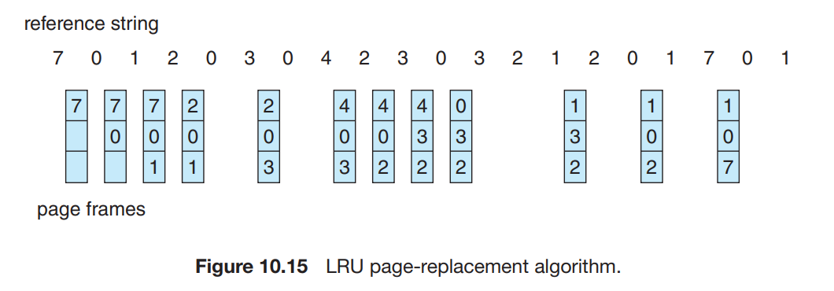
Apply the LRU page replacement algorithms for the following page-reference strings:7 0 1 2 0 3 0 4 2 3 0 3 2 1 2 0 1 7 0 1

Slide 22
the first five faults are the same as those for optimal replacement.
When the reference to page 4 occurs, however, LRU replacement sees that, of the three frames in memory, page 2 was used least recently. Thus, the LRU algorithm replaces page 2, not knowing that page 2 is about to be used.
When it then faults for page 2, the LRU algorithm replaces page 3, since it is now the least recently used of the three pages in memory.
Despite these problems, LRU replacement with twelve faults is much better than FIFO replacement with fifteen.

Slide 23
Two ways of implementing LRU :
Counters:
  In the simplest case, we associate with each page-table entry a time-of-use field and add to the CPU a logical clock or counter.
Stack :
  Approach to implementing LRU replacement is to keep a stack of page numbers. Whenever a page is referenced, it is removed from the stack and put on the top.
  In this way, the most recently used page is always at the top of the stack, and the least recently used page is always at the bottom
  Because entries must be removed from the middle of the stack, it is best to implement this approach by using a doubly linked list with a head pointer and a tail pointer

Slide 24
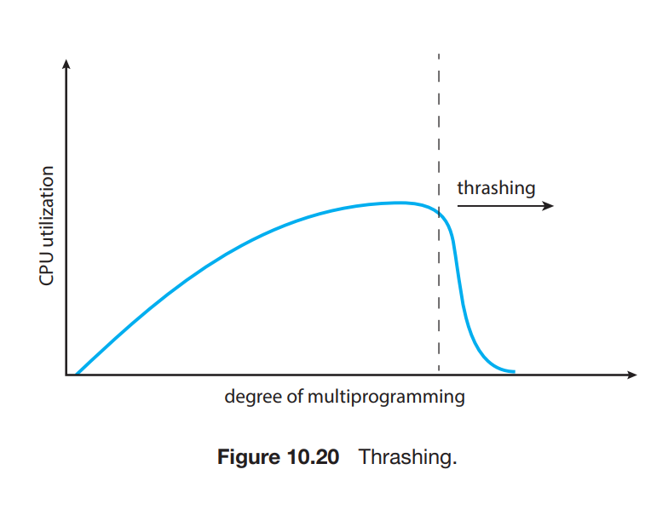
4. Thrashing
Thrashing is a condition or a situation when the system is spending a major portion of its time servicing the page faults, but the actual processing done is very negligible.
Causes of thrashing:
  High degree of multiprogramming.
  Lack of frames.
  Page replacement policy.

